Slide 1
Final Project Submission - Sales Performance vs Target
File created on: 10/3/2021 9:48:13 AM

Slide 2
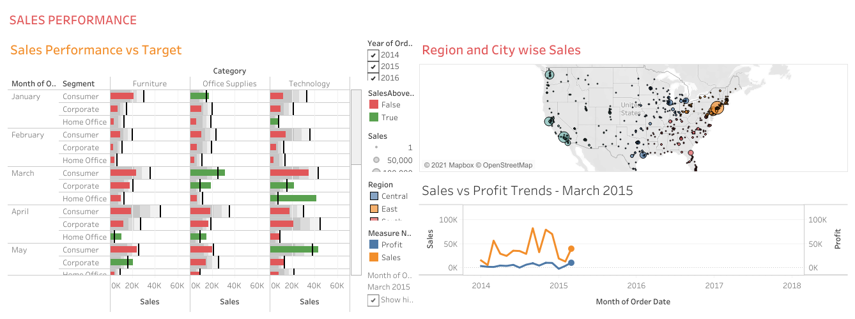

Slide 3
Objective
To build a dashboard that will present monthly sales performance by product segment and product category to help client identifying the segments and categories that have met or exceeded their sales targets, as well as those that have not met their sales targets.
Domain- Ecommerce
Datasets Used: Sample - Superstore and Sales Target(upload on github)

Slide 4
Within this file you will find the following fields:
Field | Description
Row ID | Observation Index
Order ID | Unique Order ID of a product
Order Date | Order Placement Date
Ship Date | Shipment Date of the placed order
Ship mode | Shipment mode of the placed order
Customer ID | Unique Customer ID
Customer Name | Name of the Customer
Segment | Product Segment (i.e.HomeOffice/Corporate/Consumer etc.)
Country | Unique Country Name
City | Unique City Name
State | Unique State Name
Postal Code | Area wise Postal code
Region | Especially the part of a country
Product ID | Unique Id respective to Product
Category | Product category
Sub-Category | Product Subcategory
Product Name | Unique Product Name
Sales | Sales Amount
Quantity | The amount or number of a material
Discount | A deduction from the usual cost of something
Profit | Obtain a financial advantage or benefit

Slide 5
Sales-Target will cover the target data;
Within this file you will find the following fields:
Field | Description
Category | Product category
No. of Records | Unique Record
Order Date | Order Placement Date
Sales Target | Targeted Sales to be achieved
Segment | Product Segment (i.e.HomeOffice/Corporate/Consumer etc.)

Slide 6
Analysis Tasks
Use the Saved Sample – Superstore dataset.
Create a bullet chart with Category and Segment dimensions and Sales measures.
Blend the data with the Saved Sample - Sales Target data set to bring in the Sales Target measure.
Color code the chart to identify Categories and Segments that are above or below target.
Add the year of sales to the view to identify trends and outliers.
Add a filter so that the user can select one, more than one, or all years.
Create a dashboard with this view.

Slide 7
Refer to Git hub link:-
https://github.com/manishjuit/Tableau-Sales-and-Performance-Dashboard-and-Story-Creation
Or tableau public link:
https://public.tableau.com/app/profile/manish8712/viz/FinalProjectSubmission-SalesPerformancevsTarget/SalesvsProfitTrends

